Slide 1
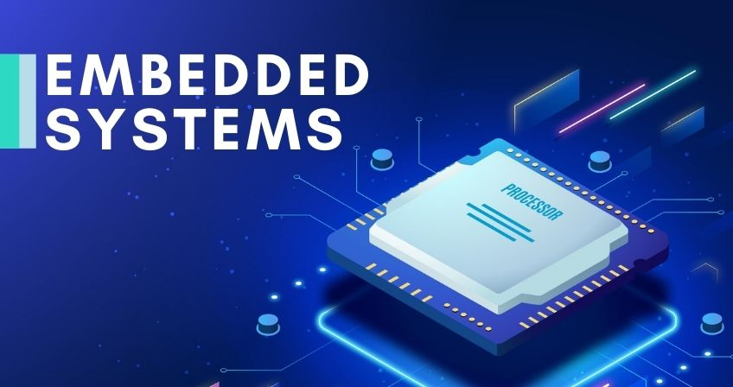
ET2223 Microprocessors Microcontrollers & Embedded Systems
Dr Budditha Hettige
Department of Computer Engineering
General Sir John Kotelawala Defence University

Slide 2
Introduction

Slide 3
Contents
What is embedded systems?
Applications
Embedded system components
Development process of the Embedded Systems
Hardware
Software
Embedded system programming

Slide 4
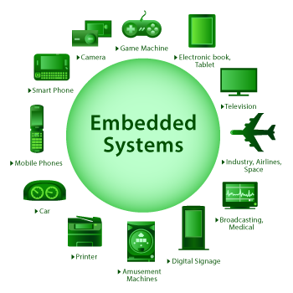
Introduction
What is an “Embedded system”?
Embedded system is a system that has embedded software and hardware, which makes it a system dedicated for an application or product or a part of a larger system.
Definition:
An embedded system is a controller with a dedicated function within a larger mechanical or electrical system. [Wikipedia]
“Any sort of device which includes a programmable computer but itself is not intended to be a general-purpose computer” [Wayne Wolf]

Slide 5
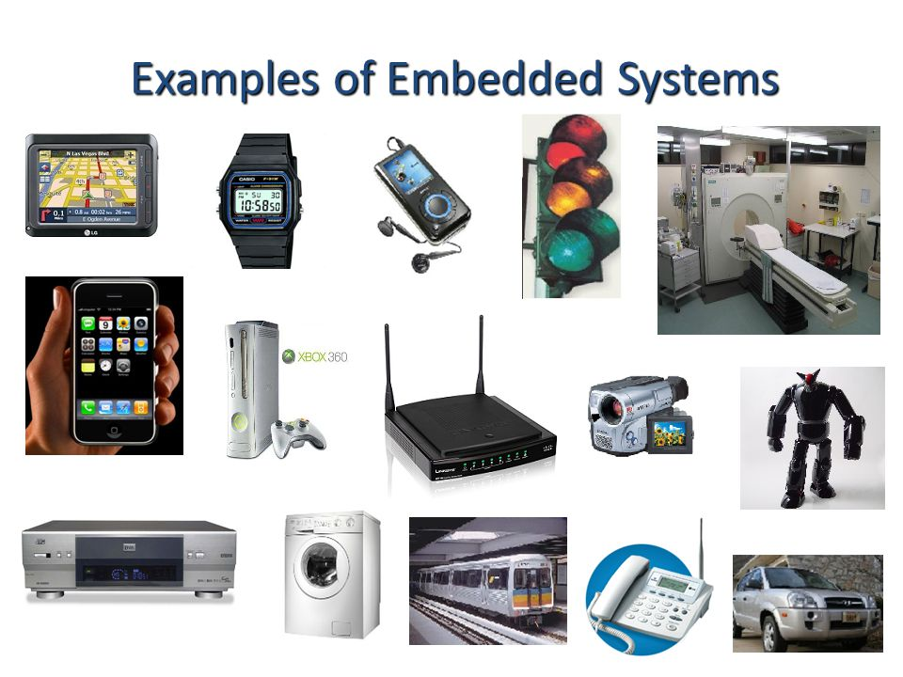

Slide 6
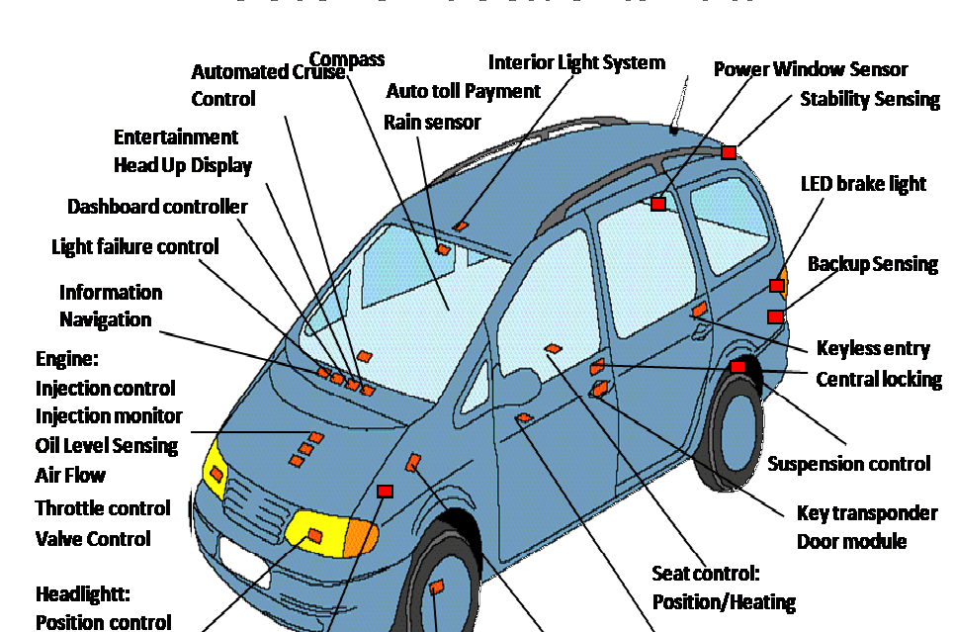

Slide 7
How many do we use?
Average middle-class American home has 40 to 50 embedded processors in it
Microwave, washer, dryer, dishwasher, TV, VCR, stereo, hair dryer, coffee maker, remote control, humidifier, heater, toys, etc.
Luxury cars have over 60 embedded processors
Brakes, steering, windows, locks, ignition, dashboard displays, transmission, mirrors, etc.
Personal computers have over 10 embedded processors
Graphics accelerator, mouse, keyboard, hard-drive, CD-ROM, bus interface, network card, etc.
- Mike Schulte

Slide 8
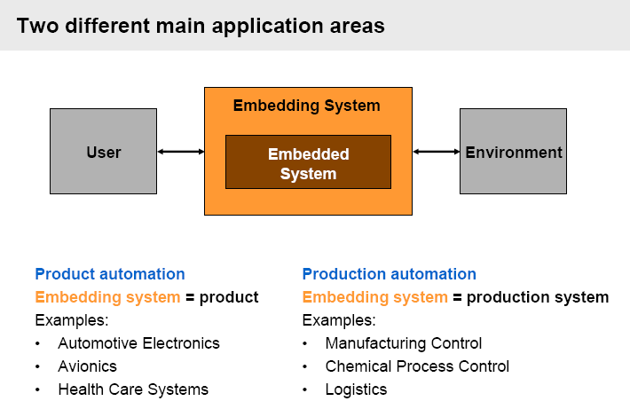
Applications

Slide 9
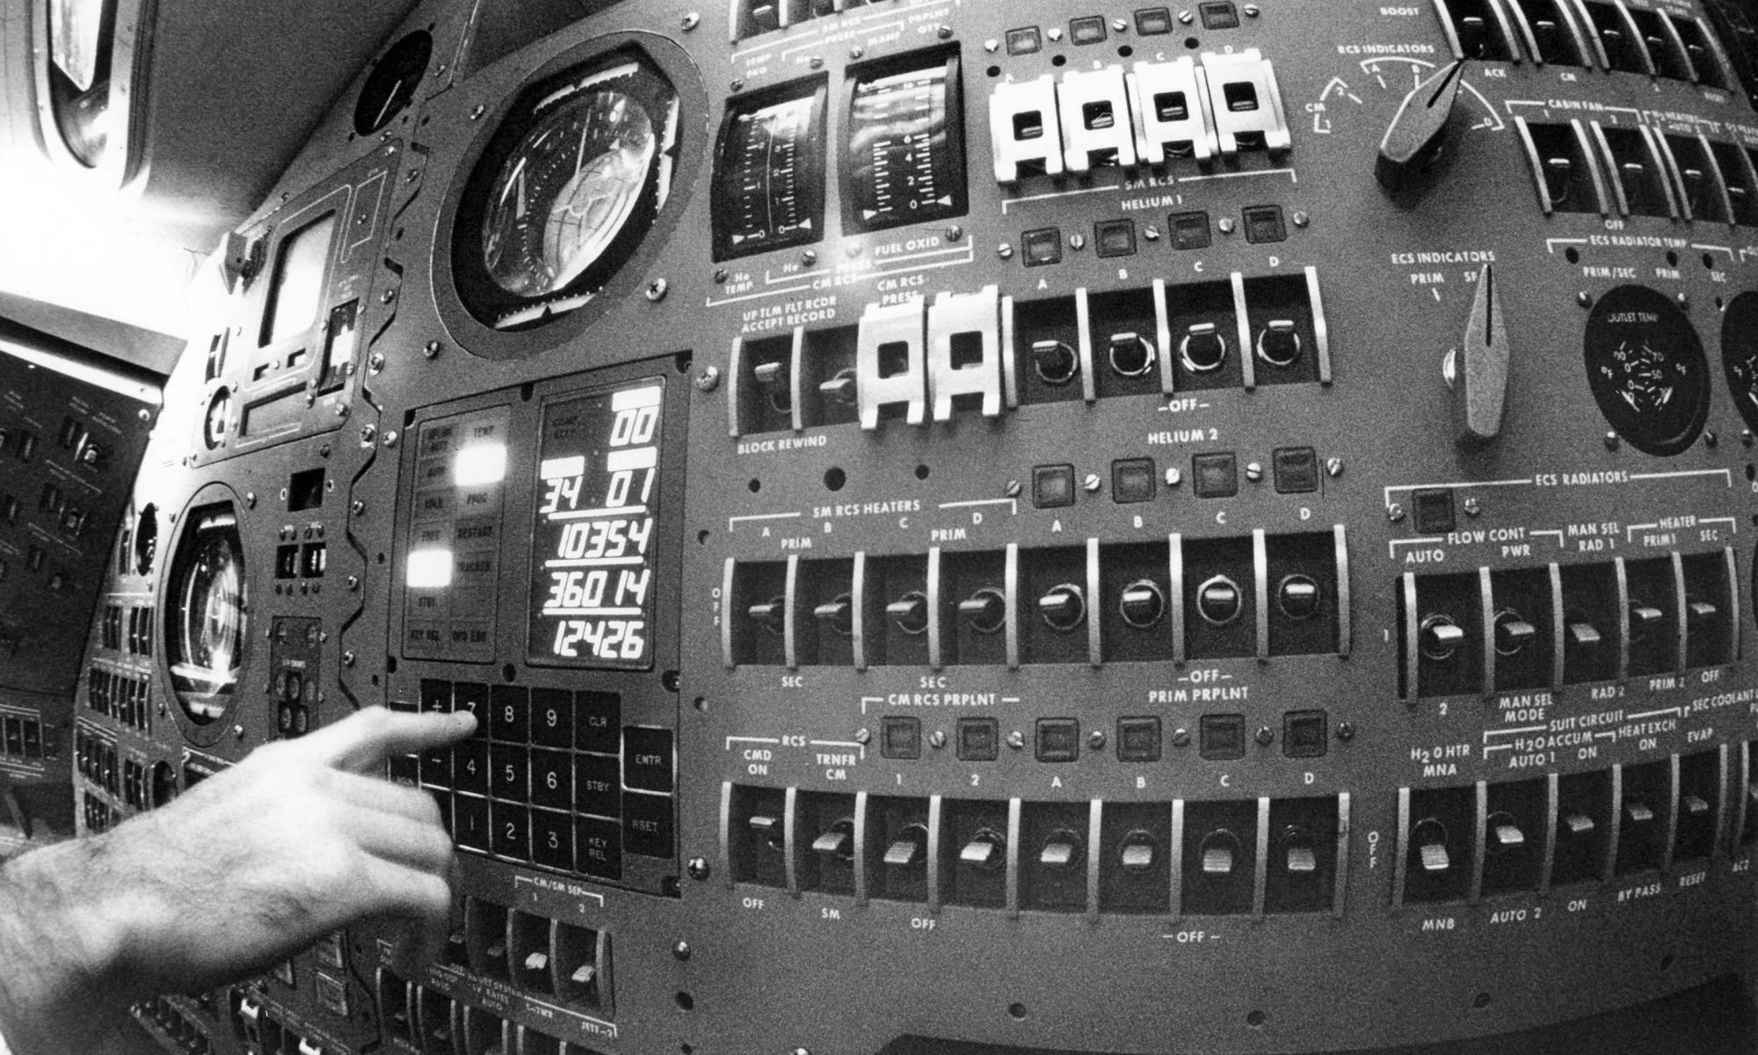
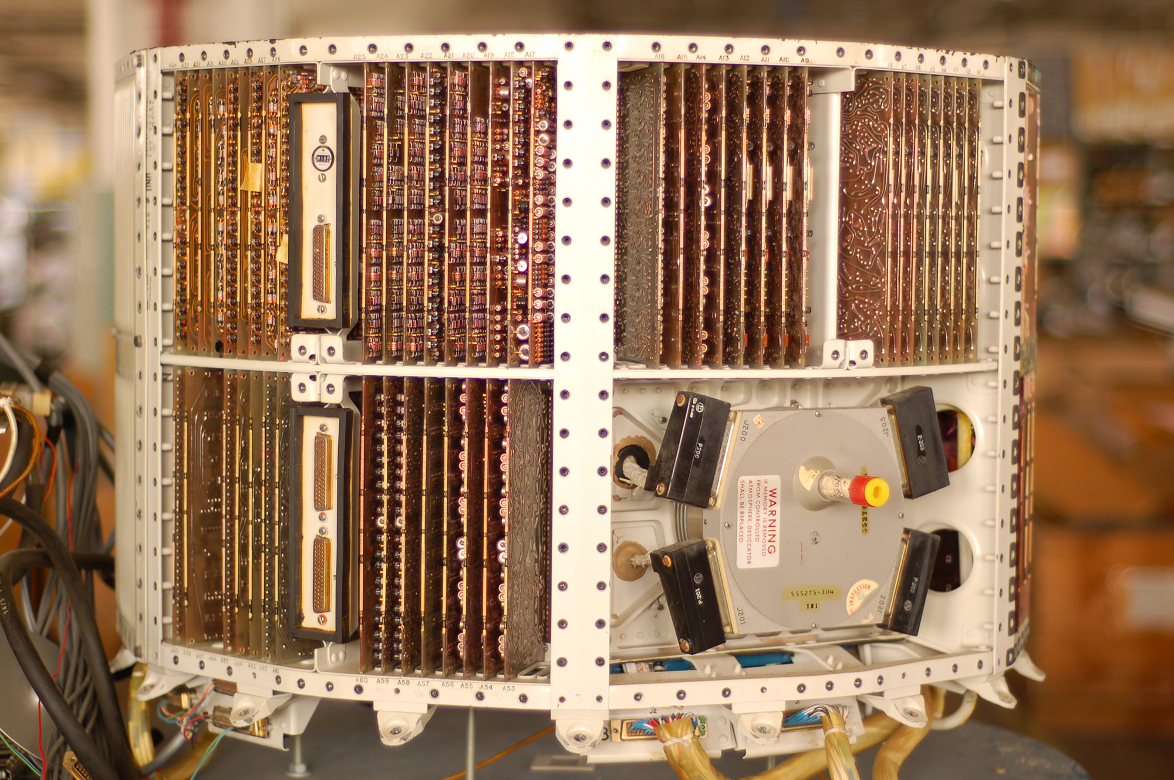
History
1960s. Charles Stark Draper developed an integrated circuit in 1961 to reduce the size and weight of the Apollo Guidance Computer
In 1965, Autonetics, now a part of Boeing, developed the D-17B, the computer used in the Minuteman I missile guidance system.
1968, the first embedded system for a vehicle was released; the Volkswagen 1600 used a microprocessor to control its electronic fuel injection system.
First microcontroller was developed by Texas Instruments in 1971.

Slide 10

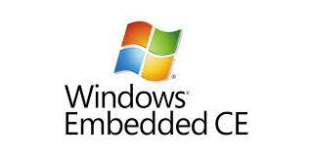
History
1971, Intel released what is widely recognized as the first commercially available processor, the 4004
In 1987, the first embedded operating system, the real-time VxWorks, was released by Wind River.
Microsoft's Windows Embedded CE was released in 1996.
1990s, the first embedded Linux products began to appear.
Today, Linux is used in almost all embedded devices.

Slide 11
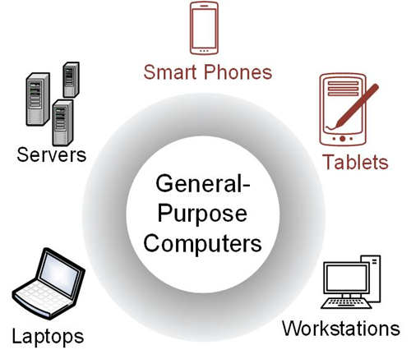
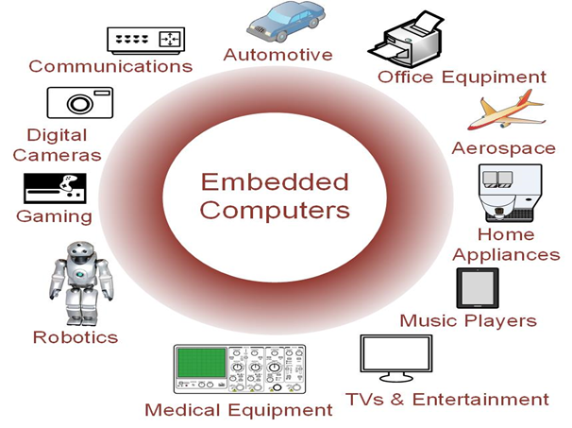
Computers vs ES

Slide 12
General purpose Computers vs ES
Computers
Able to run a variety of software.
Contain relatively high-performance hardware components (fast processors, data & program storage).
Require an operating system (OS).
Designed for heavy user interaction.
Uses a variety of peripherals (displays, keyboards, mice, internet connections, wireless communication capability).
ES
Resources can be implemented on a single IC.
Include a variety of peripherals (timers, analog-to-digital converters, digital-to-analog converters, serial interfaces).
Small size makes them very versatile.
Contains firmware (only the needed software which is not intended to be changed frequently).
May contain Real Time Operating Systems (RTOS) which are used as a task scheduler.
Low cost (10s of cents to a few dollars).

Slide 13
Introduction
What is an “Embedded system” ?
Difficult to define, in general “Any computer system which is not a general purpose computer”
Characteristics of Embedded System
Single Functioned
Tightly Constrained
Reactive and Real Time
3 main components :
1. Hardware
2. Application Software
3. System Software (may be RTOS)

Slide 14
Introduction
Typical components of an Embedded system
Sensors: Allow the system to “read” the environment
Processing Elements: Control of the embedded system
Actuators: Allow the system to act on its environment
Network Connection: Local or internet, allowing exchange of information
Billions of units produced yearly, versus millions of desktop units
Perhaps 50 per household and per automobile
A lot more programming is done for embedded systems than desktop computers or servers

Slide 15
Block Diagram

Slide 16
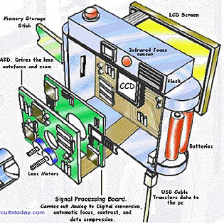
ES
Single-functioned -- always a digital camera
Tightly-constrained -- Low cost, low power, small, fast
Reactive and real-time -- only to a small exten

Slide 17
Embedded systems
The global market for the embedded systems industry was valued at $68.9 billion in 2017 and is expected to rise to $105.7 billion by the end of 2025.
Key Challenges
Stability,
Safety,
Security
Design :
Low power, Small Form factor etc..
Compatibility and integrity
Connectivity
Debugging
Rate of change

Slide 18
Different types of ES
General Computing
Applications similar to desktop computing, but in an embedded package
Video games, set-top boxes, wearable computers, automatic tellers
Tablets, Phablets
Control Systems
Closed loop feedback control of real time system
Vehicle engines, chemical processes, nuclear power, flight control

Slide 19
Different types of ES
Signal Processing
Computations involving large data streams
Radar, Sonar, video compression
Communication and Networking
Switching and information transmission
Telephone system, Internet
Wireless everything

Slide 20
Typical Constraints of ES
Small Size, Low Weight
Handheld electronics ■ Transportation applications weight costs money
Low Power
Battery power for 8+ hours (laptops often last only 2 hours)
Limited cooling may limit power even if AC power available
Harsh environment
Heat, vibration, shock
Power fluctuations, RF interference, lightning
Water, corrosion, physical abuse
Safety critical operation
Must function correctly, Must not function incorrectly
Extreme cost sensitivity
$.05 adds up over 1,000,000 units

Slide 21
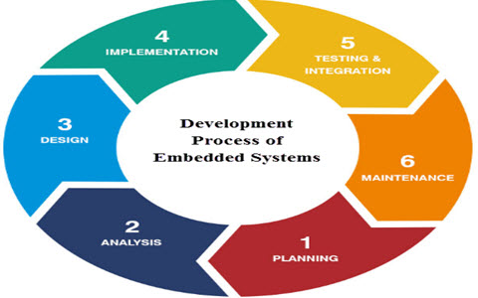
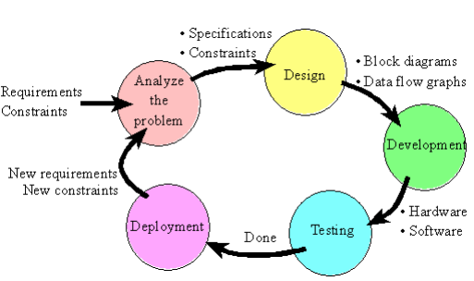
Development Process

Slide 22
Design Challenges
Must fulfill desired requirements
Key Challenge is to simultaneously optimize many design metrics
Design Metric
Measurable feature of system implementation

Slide 23
Common Design Metrics
Unit cost: the monetary cost of manufacturing each copy of the system, excluding NRE cost
NRE cost (Non-Recurring Engineering cost): The one-time monetary cost of designing the system
Size: the physical space required by the system
Performance: the execution time or throughput of the system
Power: the amount of power consumed by the system
Flexibility: the ability to change the functionality of the system without incurring heavy NRE cost

Slide 24
Common Design Metrics
Time-to-prototype: the time needed to build a working version of the system ○ Time-to-market: the time required to develop a system to the point that it can be released and sold to customers
Maintainability: the ability to modify the system after its initial release
Correctness, safety, many more
Expertise with both software and hardware is needed to optimize design metrics (Can consider as another challenge)
A designer must be comfortable with various technologies in order to choose the best for a given application and constraints

Slide 25
Cost
Unit cost: the monetary cost of manufacturing each copy of the system, excluding NRE cost
NRE cost (Non-Recurring Engineering cost): The one-time monetary cost of designing the system
Total cost = NRE cost + unit cost * # of units
per-product cost = total cost / # of units
= (NRE cost / # of units) + unit cost

Slide 26
Time to Market
Time required to develop a product to the point it can be sold to customers
Market window
Period during which the product would have highest sales
Average time-to-market constraint is about 8 months
Delays can be costly

Slide 27
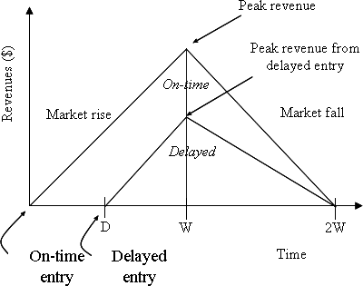
Embedded Systems - Introduction
●
Time to Market : Simplified
Revenue Model
○
Product life = 2W, peak at W
Time of market entry defines a
triangle, representing market
penetration
○
○
Triangle area equals revenue
Loss
The difference between the on-time and delayed triangle areas

Slide 28
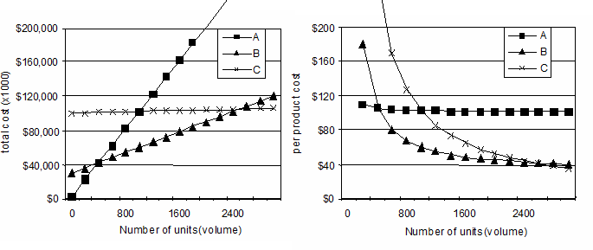
Embedded Systems - Introduction
Costs
Compare technologies by costs -- best depends on quantity Technology A: NRE=$2,000, unit=$100
Technology B: NRE=$30,000, unit=$30 Technology C: NRE=$100,000, unit=$2

Slide 29
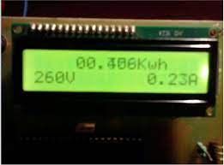
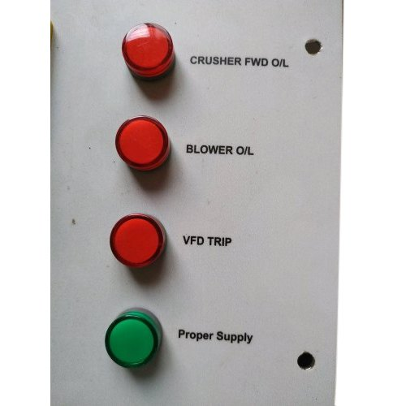
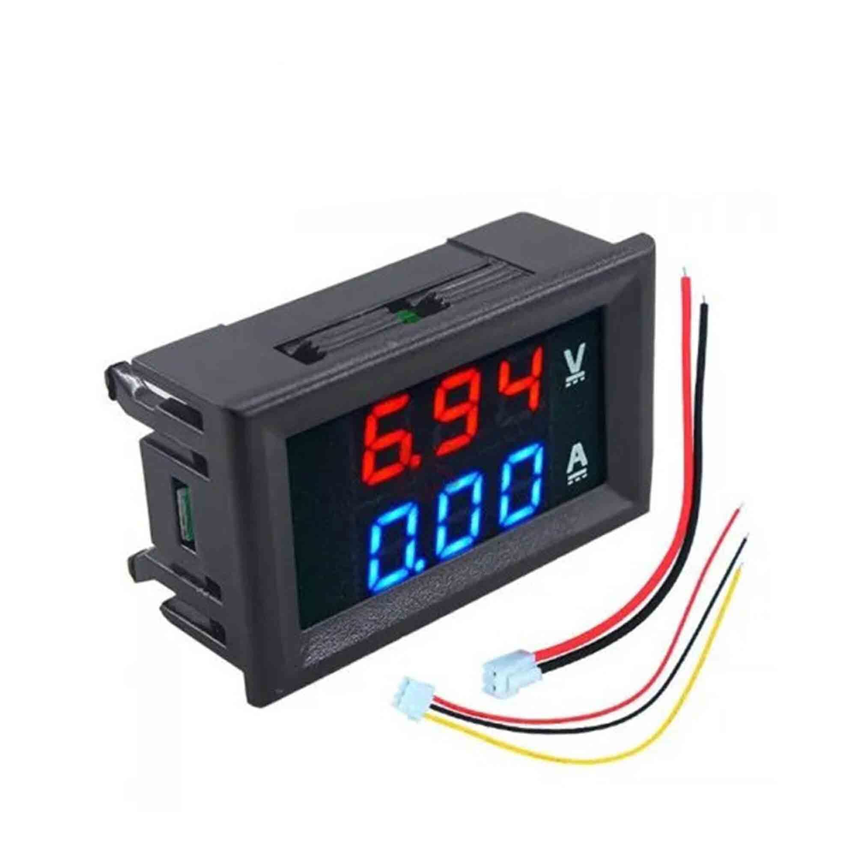
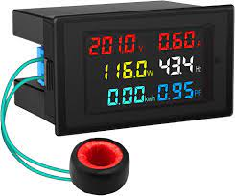
Requirements vs Cost

Slide 30
Performance
Clock frequency, instructions per second – not good measures
Digital camera example – a user cares about how fast it processes images, not clock speed or instructions per second
Latency (response time)
Time between task start and end e.g., Camera’s A and B process images in 0.25 seconds
Throughput
Tasks per second, e.g. Camera A processes 4 images per second
Throughput can be more than latency seems to imply due to concurrency, e.g. Camera B may process 8 images per second (by capturing a new image while previous image is being stored).
Speedup of B over S = B’s performance / A’s performance
Throughput speedup = 8/4 = 2

Slide 31
Stability
ability of an embedded system to perform its intended functions reliably and consistently over time
Stability is a crucial aspect of embedded systems, as they are often used in critical applications where any failure or unexpected behavior can have serious consequences.
Factors
Hardware Reliability: The underlying hardware components, such as microcontrollers, sensors, and other peripherals, should be reliable and capable of withstanding the operating conditions.
Software Robustness: The embedded software running on the system should be well-designed, efficient, and free from bugs.

Slide 32
Stability Factors.
Real-time Responsiveness: Many embedded systems require real-time responses to external events or inputs.
Power Management: Embedded systems are often powered by batteries or other limited power sources. Effective power management techniques should be implemented to optimize power consumption.
Maintenance and Updates: Embedded systems may require occasional firmware updates or software patches to address bugs, security vulnerabilities, or add new features.
Validation and Certification: In safety-critical applications, embedded systems may need to undergo rigorous validation and certification processes.

